Slide 1

Harnessing Vesicular Arbuscular Mycorrhizal (VAM) Inoculants Enhanced with Beneficial “Third Symbionts” For Sustainable Agriculture (Phase II)
Dr. Marilyn B. Brown
Paper presented during the Annual ANMICRO meeting held in Pullman Kuching, Sarawaak, Malaysia last April 26, 2018

Slide 2
BRIEF BACKGROUND
“Third Symbionts”
Mychorriza Helpers
Living inside the VAM fungal partner or at the mycorrhizosphere
Have genes involved in the greater acquisition of mineral nutrients.
Beneficial microorganisms:
Free-living Nitrogen-fixing bacteria (NFB)
Phosphate-solubilizing bacteria (PSB)
Phosphate-solubilizing fungi(PSF)
Plant growth promoting rhizobacteria (PGPR)
Other beneficial actinomycetes

Slide 3
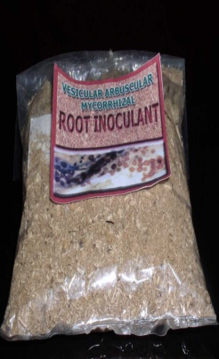
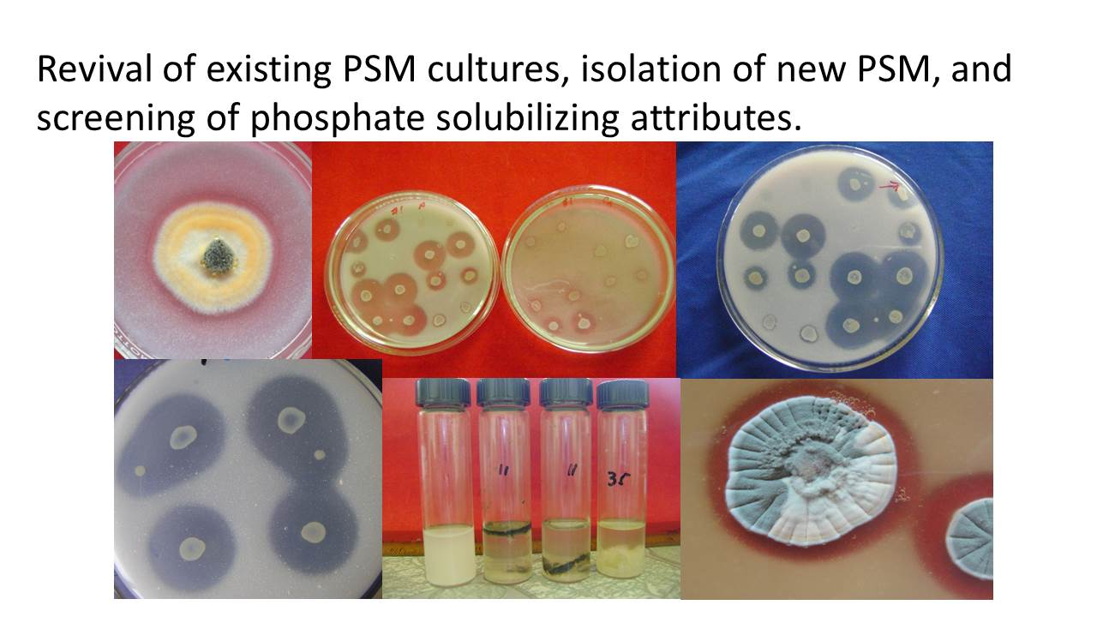
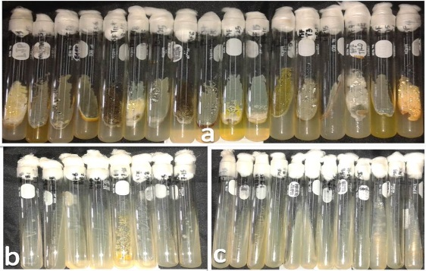
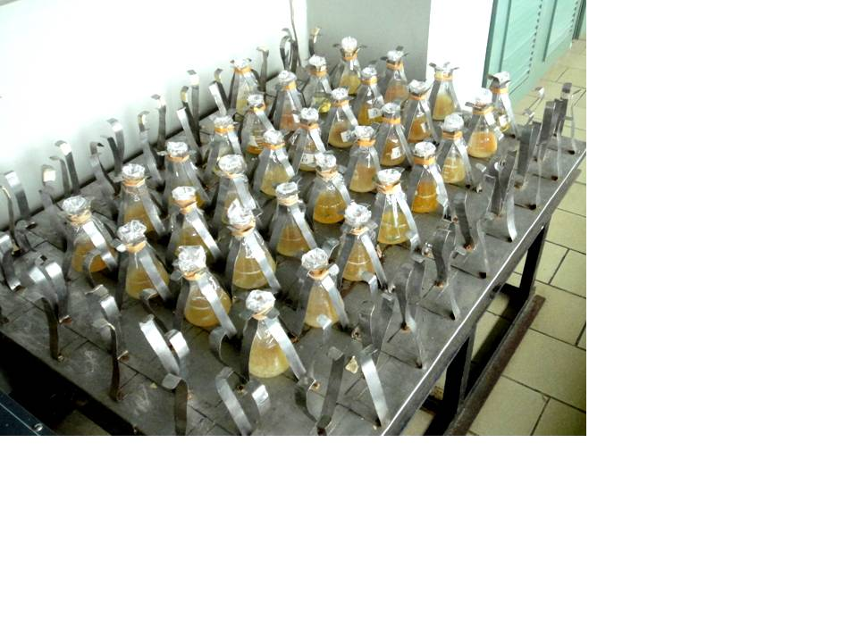
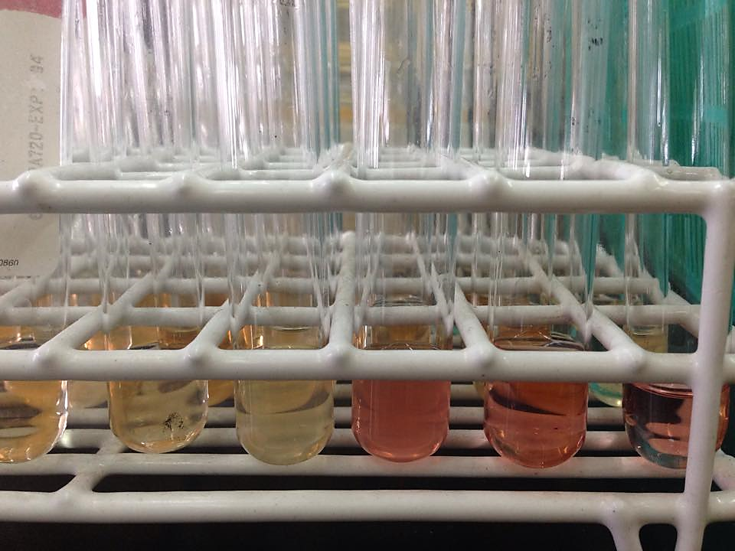
BRIEF BACKGROUND
Plant growth promoting attributes:
Indole Acetic Acid (IAA)
Phosphate Solubilization (PSM)
ACC deaminase
Siderophore Production
SOIL, ROOTS, and PNCM Culture Collection
Isolate
Assay for
P-solubiliuzation
BACTERIA and MOLDS
IAA
Pure culture of microbial isolates with PGP attributes
P-solubilizing fungi

Slide 4
GENERAL OBJECTIVE
To enhance existing BIOTECH mycorrhizal inoculants with “third symbionts” for sustainable agriculture.

Slide 5

SIGNIFICANT RESULTS
STUDY 1. Assessment of the Interaction Effect of Existing Vesicular Arbuscular Mycorrhizal (VAM) Inoculant and Screened “third symbionts”.
SELECTED THIRD SYMBIONTS USED
NFB: PSB:
T1B4 - U9 Unidentified T2B2 - Ralstonia sp.
T1B7 - U12 Unidentified T2B6 - Klebsiella sp.
T1B8 - Acetobacter sp. T2B8 - Burkholderia sp.
PSF: GROWTH PARAMETERS:
T2M5 – Aspergillus sp. HEIGHT
T2M6 – Sterile Mycelia FRESH WEIGHT
T2M10 – Penicillium sp. OVEN DRY WEIGHT

Slide 6
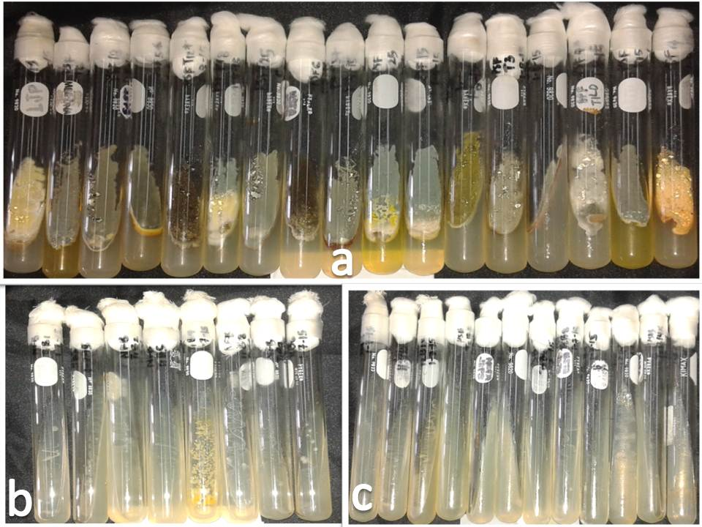
SIGNIFICANT RESULTS
STUDY 1. Assessment of the Interaction Effect of Existing Vesicular Arbuscular Mycorrhizal (VAM) Inoculant and Screened “third symbionts”. Dr. Marilyn B. Brown

Slide 7
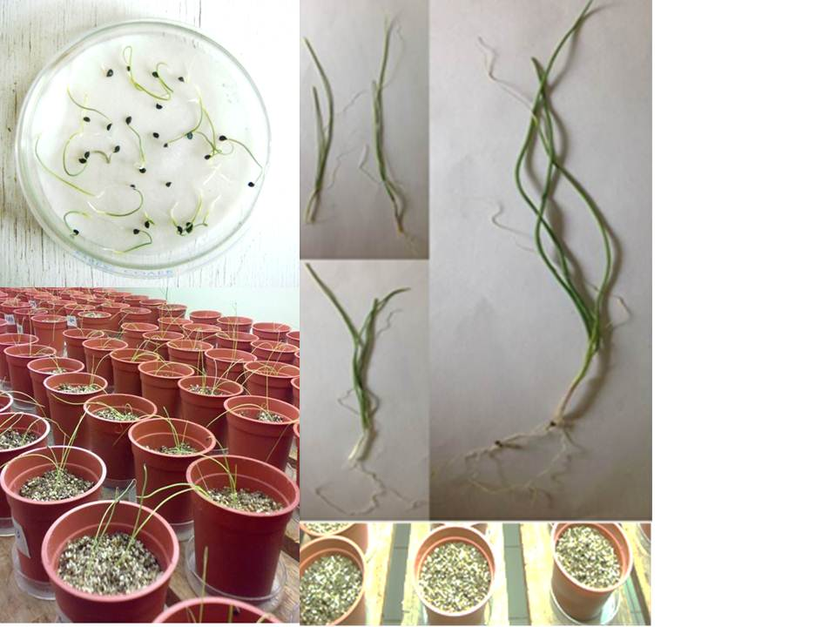
SIGNIFICANT RESULTS
ONIONS
I. Interaction Effect of VAMRI and Revived Isolates on Onion under Growth room conditions
Nitrogen fixing bacteria and VAMRI
Among the mycorrhizal plants treated with NFB, T1B8 had positive interaction effect with VAMRI.
Phosphate solubilizing fungi and VAMRI
T2M5, T2M6, and T2M10
Phosphate-solubilizing bacteria and VAMRI
T2B2, T2B6, and T2B8
Notes:
Experimental set up of onion maintained in growth room conditions

Slide 8
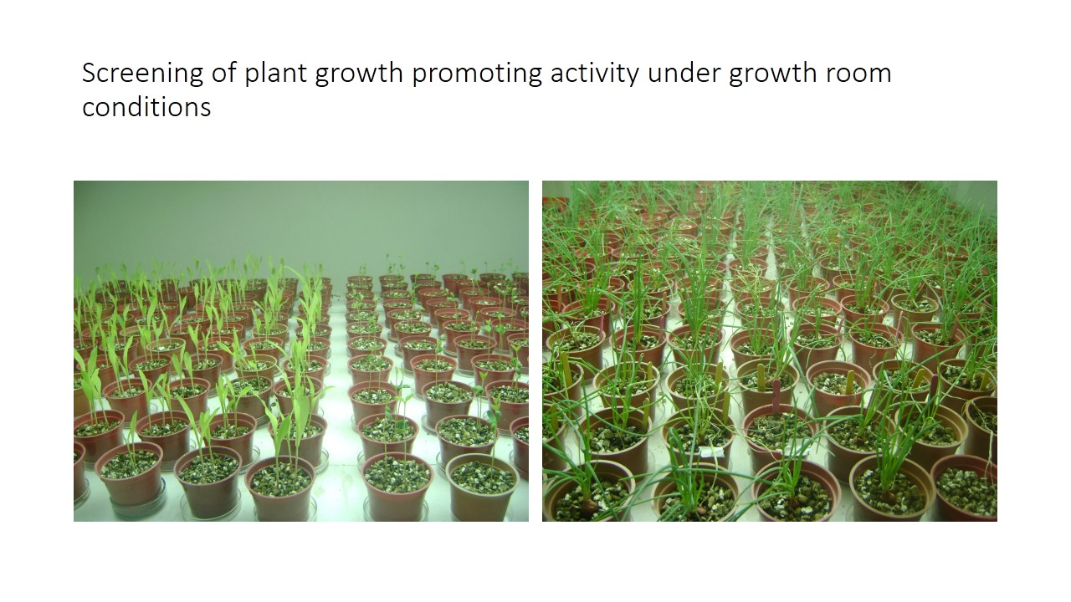
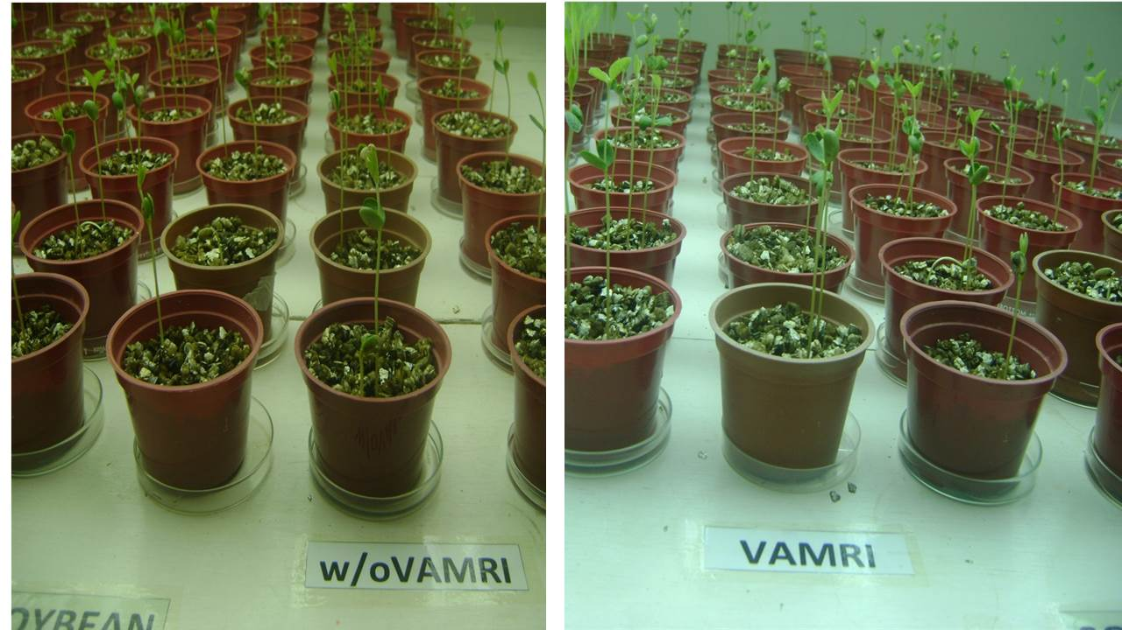
Experimental set –up for the evaluation of the interaction effect of suspected newly screened “third symbionts” and VAMRI in onion, corn and soybean in growth room condition.

Slide 9
SIGNIFICANT RESULTS
RICE
Interaction Effect of VAMRI and Phosphate Solubilizing Fungi on Rice under screenhouse conditions
For direct seeded mycorrhizal rice:
T2M10
For transplanted mycorrhizal rice:
T2M6
Notes:
Interaction effect of direct seeded mycorrhizal rice inoculated with T2M10 (T6) and transplanted mycorrhizal rice inoculated with T2M6 (T5) compared to the uninoculated control (T1) under screenhouse conditions.

Slide 10
SIGNIFICANT RESULTS
MUNGBEAN
Notes:
FRESH WEIGHT of mungbean as affected by the interaction effect of N-fixing bacteria, P-solubilizing fungi and VAMRI.
THE ENCIRCLED TRT, THE MYCORRHIZAL PLANTS INOCULATED WITH T1B8 (ACETOBACTER SP.) + T2M10 (PENICILLIUM SP.) HAD THE HIGHEST FRESH WEIGHT AND IT IS SIGNIFICANTLY DIFFERENT FROMTHE UNINOCULATED CONTROL AND THE NON-MYCORRHIZAL PLANTS INOCULATED WITH THE SAME INOCULANT.

Slide 11
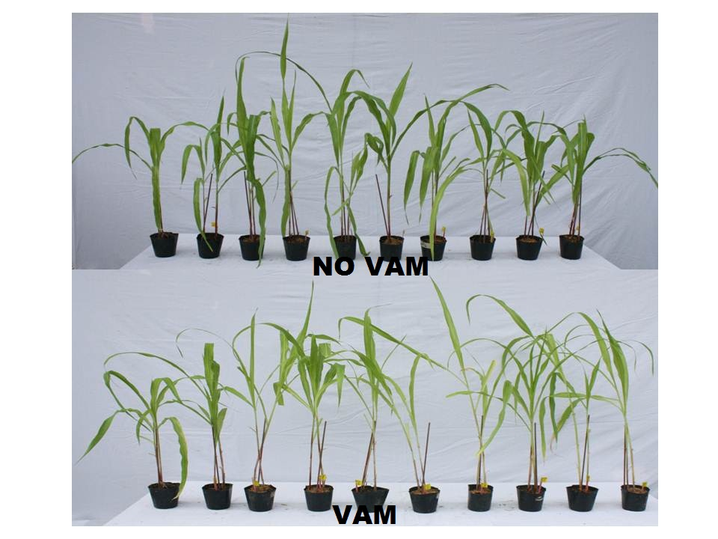
SIGNIFICANT RESULTS
CORN
Notes:
Experimental set-up to determine the interaction effect of putative “third symbionts” and VAMRI on corn under screenhouse conditions

Slide 12
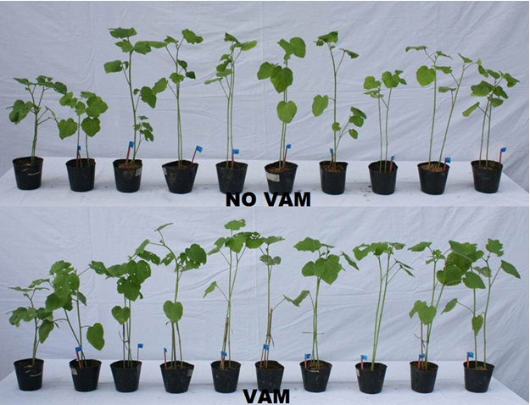
SIGNIFICANT RESULTS
OKRA
Notes:
Experimental set-up to determine the interaction effect of putative “third symbionts” and VAMRI on OKRA under screenhouse conditions

Slide 13
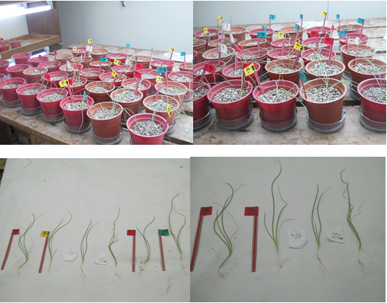
INTERACTION OF PSB AND PSF WITH AND WITHOUT VAMRI (GR)
T2B2 Ralstonia sp. (PSB) + T2M6 Sterile mycelia (PSF) or T2M10 Penicillium sp. (PSF)
T2B6 Klebsiella sp. (PSB) + T2M6 Sterile mycelia (PSF) or T2M10 Penicillium sp. (PSF)
T2B8 Burkholderia sp. (PSB) + T2M6 Sterile mycelia (PSF) or T2M10 Penicillium sp. (PSF)
Notes:
Experimental set up of onion maintained in growth room conditions

Slide 14
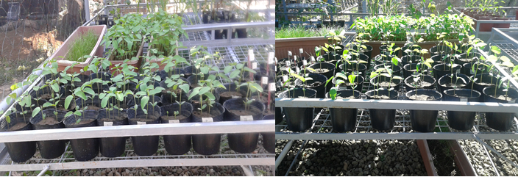
INTERACTION OF PSB AND PSF WITH AND WITHOUT VAMRI (SCREENHOUSE)
T2B8 Burkholderia sp. (PSB) + T2M6 Sterile mycelia and T2M10 Penicillium sp. (PSF) on mycorrhizal soybean.
Notes:
Experimental set up of soybean maintained in screenhouse conditions

Slide 15
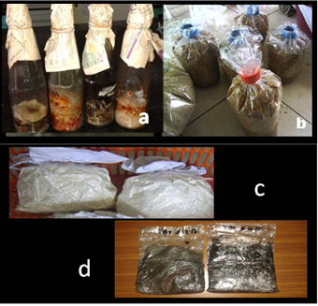
Determination of the Most Effective Formulation Carrier of the “third symbionts” compatible with VAM Inoculant
The starter inoculum and carrier formulations of the best isolates (a. inoculated sorghum seeds (starter inocula), b. sawdust and rice hull, c. fungal spawn and d. bacterial inoculant on ground charcoal with pulverized soil).

Slide 16
SIGNIFICANT RESULTS
Study 4. Evaluation of the Effectiveness of the Enhanced VAM Inoculant in Promoting Growth and Yield of Various Important Agricultural Crops under Different Soil/Environmental Conditions. Dr. Marilyn B. Brown and Dr. Mannix S. Pedro
Acidic soil collected from Cavinti, Laguna and Taytay, Rizal were used to assess the effectiveness of the VAMRI enhanced with third symbionts. Garden soil with a pH of 6 was used as a basis of comparison.

Slide 17
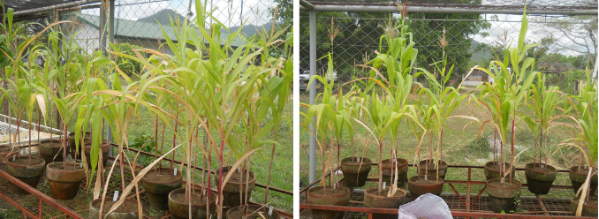
INTERACTION OF PSF AND VAMRI IN ACIDIC SOIL pH 4.8 (SCREENHOUSE)
II. Interaction effect of Phosphate solubilizing fungus (T2M6 Sterile mycelia) on mycorrhizal corn.
Notes:
Experimental set up of corn maintained in screenhouse conditions

Slide 18
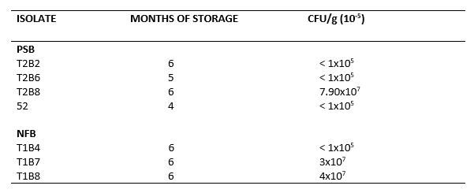
Shelf Life Monitoring
Population of third symbionts per gram of charcoal (average colony forming units)

Slide 19
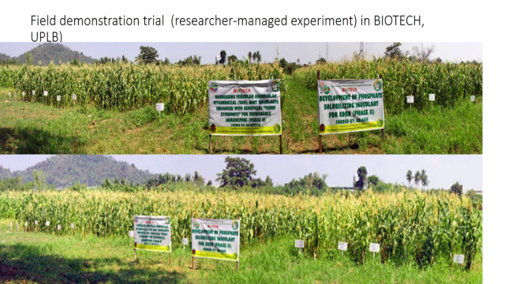
On-Farm Demonstration Trials of the Effectiveness of Enhanced VAM Inoculants
Field Demonstration Trial (Research-Managed Experiment) in BIOTECH, UPLB

Slide 20
On-Farm Demonstration Trials of the Effectiveness of Enhanced VAM Inoculants
Weight of green yield of corn as affected by selected (putative) “third symbionts”
of VAMRI in combination with chemical fertilizers and BioGreen.
Code | Treatment | Weight (kg/plot)
T1 | Control | 3.80 | d
T2 | 1/2 RRC | 8.33 | bcd
T3 | RRC | 9.03 | abc
T4 | 1/2 RRC + VAMRI | 9.53 | abc
T5 | RRC + VAMRI | 9.33 | abc
T6 | VAMRI | 9.76 | abc
T7 | 1/2 RRC + 52 | 9.17 | abc
T8 | RRC + 52 | 12.00 | ab
T9 | VAMRI + 52 | 9.80 | abc
T10 | 1/2 RRC + VAMRI + 52 | 9.40 | abc
T11 | RRC + VAMRI + 52 | 11.73 | ab
T12 | VAMRI + BIOGREEN | 5.80 | cd
T13 | VAMRI + BG | 9.67 | abc
T14 | 1/2 RRC + BG | 13.83 | a
T15 | 1/2 RRC + T2B8 | 4.67 | cd
T16 | VAMRI + T2B8 | 10.17 | abc
T17 | 1/2 RRC + VAMRI + T2B8 | 13.50 | a
T18 | RRC + T2B8 | 9.02 | bc
T19 | RRC + VAMRI + T2B8 | 9.16 | bcd

Slide 21
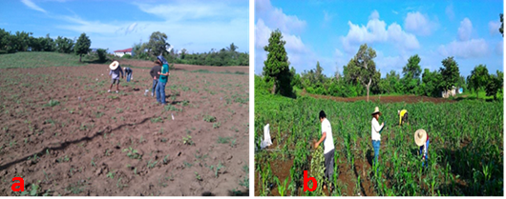
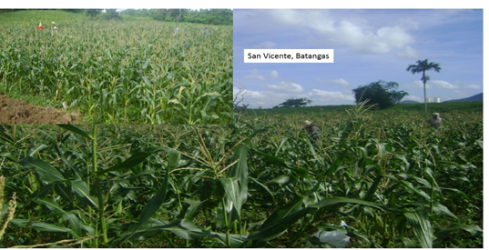
On-Farm Demonstration Trials of the Effectiveness of Enhanced VAM Inoculants
On-farm demonstration set ups (June 2015) in San Vicente

Slide 22
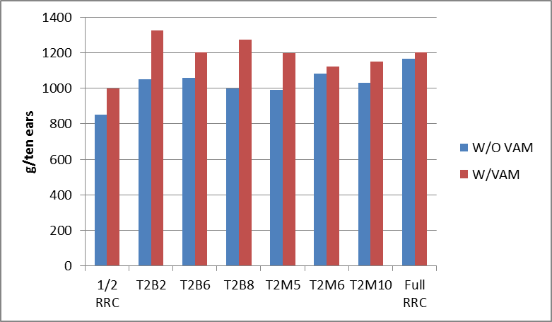
Weight of corn (ten ears) as affected by interaction of VAMRI and “third symbionts” fertilized with ½ RRC compared to full RRC.

Slide 23
Growth performance of corn inoculated with selected phosphate solubilizing microorganisms in San Vicente Sto. Tomas, Batangas.
Treatment | Plant Height (cm) |  |  | Weight of yield (g/10 plants) | Biomass yield (g/3 plants)
 | 27 dap | 49 dap | 57dap
Full | 88.6 d | 155.6 ab | 158.3 ab | 1150.0 ab | 73.8 a
Inoculated (52) | 97.1 ab | 164.3 a | 165.9 a | 1225.0 ab | 75.4 a
Inoculated (PS9) | 90.8 cd | 152.3 b | 154.2 b | 912.5 c | 68.8 abc
Inoculated (S2R1) | 92.3 bcd | 157.8 ab | 159.8 ab | 1125.0 abc | 63.8 bcd
Inoculated (T2B2) | 94.6 abc | 153.5 b | 154.9 b | 1325.0 a | 72.9 ab
Inoculated (T2B6) | 98.1 a | 158.2 ab | 159.2 ab | 1125.0 abc | 72.5 abc
Inoculated (T2B8) | 88.1 d | 154.2 b | 155.1 b | 1212.5 ab | 78.3 a
Inoculated (I2) | 90.1 bc | 144.8 d | 148.0 c | 1125.0 abc | 55.0 d
Inoculated (I5) | 98.5 a | 149.7 cd | 151.3 c | 1100.0 bc | 68.3 abcd
CV | 8.69 | 9.17 | 9.01 | 15.6 | 20.57

Slide 24
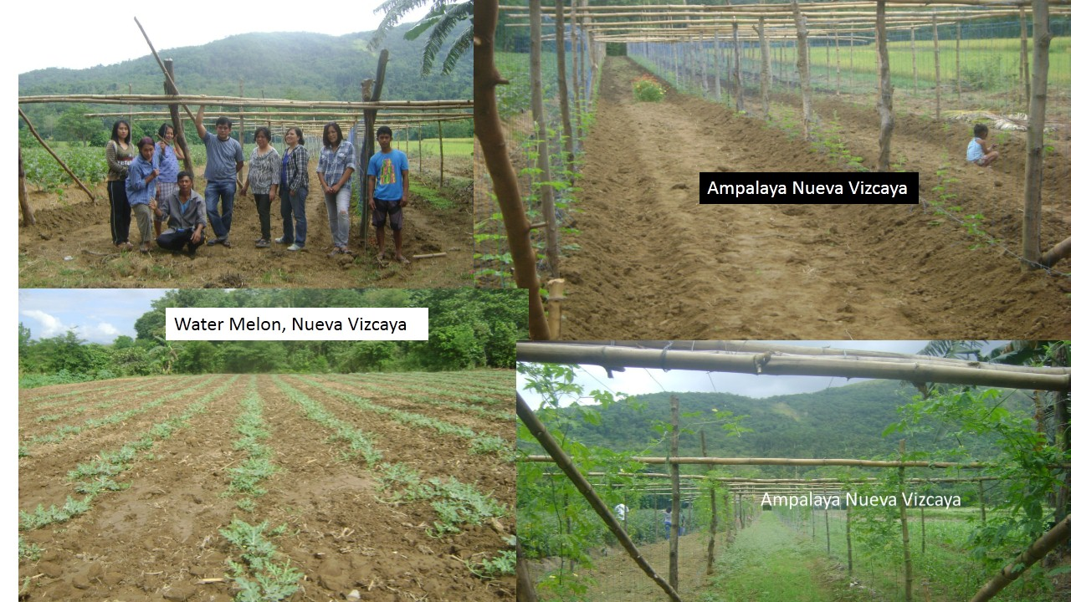
On-Farm Demonstration Trials of the Effectiveness of Enhanced VAM Inoculants
Pictures of the research-managed and on farm trials established in Nueva Vizcaya. Unfortunately, the set ups were flooded.

Slide 25
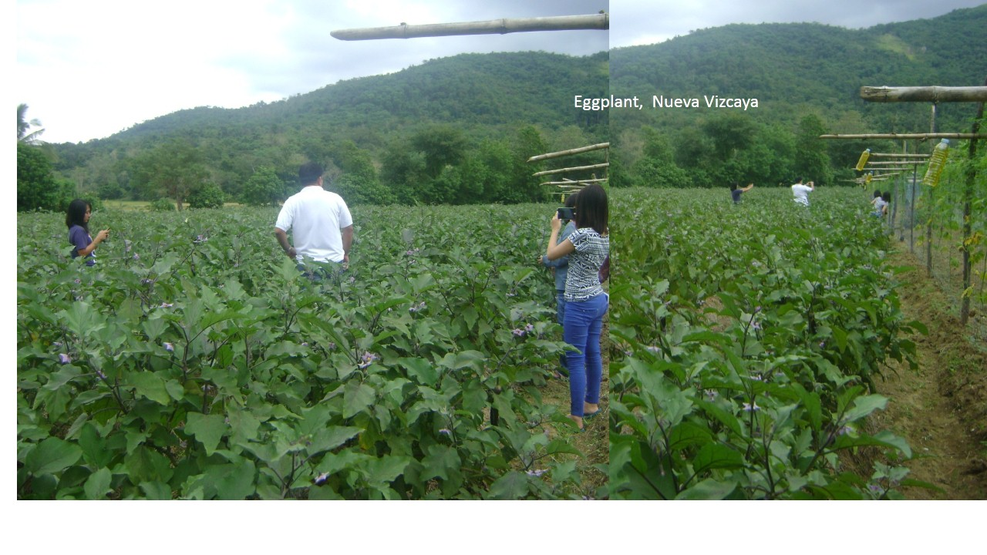
On-Farm Demonstration Trials of the Effectiveness of Enhanced VAM Inoculants
Pictures of the researched-managed and on farm trials established in Nueva Vizcaya.

Slide 26
THANK YOU VERY MUCH.

