Slide 1

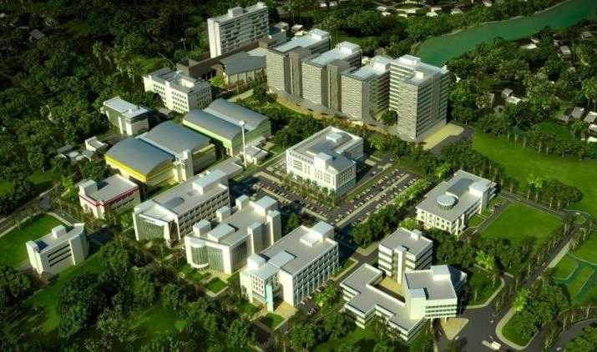
Thailand Bioresource Research Center (TBRC)
Honglada Thoetkiattikul, Ph.D.
Thailand Bioresource Research Center
National Center for Genetic Engineering and Biotechnology (BIOTEC)
National Science and Technology Development Agency
(NSTDA)
Copyright 2018, BIOTEC, THAILAND

Slide 2







NSTDA Organization
established by Sci. & Tech. Dev. Act. B.E. 2534 (1991)
1983
1985
1985
2006
2003
NSTDA : National Science and Technology Development Agency
BIOTEC : National Center for Genetic Engineering and Biotechnology
MTEC : National Metal and Materials Technology Center
NECTEC : National Electronics and Computer Technology Center
NANOTEC : National Nanotechnology Center
TMC : Technology Management Center
Copyright 2018, BIOTEC, THAILAND

Slide 3
1
2
3
BIOTEC
Modern
Agriculture
Plant/ animal breeding
Rice, sugarcane,
Cassava, Oil Palm
Shrimp
Safe agriculture
- Biocontrol
Animal Vaccines
Diagnostic kit
- Aquaculture
Plant
Strategic
PLAN
Biofuels and Biochemical Industry
4
5
6
Fractionation
and biopolymer valorization
- Bagasse
Hydrothermal/organsolv
Next-Gen enzyme/strain development
- Cassava processing
Biogas
Industry: textile, paper
Synthetic biology
- Yeast
2017-2021
7
8
Functional food ingredients
- Pre/Probiotics
- PUFA
Low GI carbohydrate
Safe Food
- Food safety
Food testing
Food for
the Future
SUSTAINABILITY
Enhancement of Public Health and Standard of Living
9
Tropical disease: diagnostic, vaccine, drug design
Prosperity
Stability
Malaria
Dengue
- Tuberculosis
PLATFORM TECHNOLOGY
Molecular breeding Platform
Gene editing
Probiotic screening Platform
Enzymatic platform
Biorefinery
platform
Rational Drug Design
ระบบทดสอบ
โดยใช้ cell line
Bioprocess
Platform (NBF)
Reverse genetics
Bioinformatics
(integrated omics)
Copyright 2018, BIOTEC, THAILAND
Notes:
Based on the national policy and NSTDA Strategic plan, BIOTEC has developed 5-year strategic research plans that intend to serve the country’s need. The targets of each research area have been identified.

Slide 4

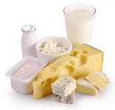


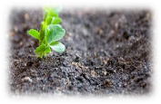
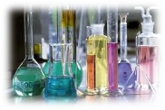
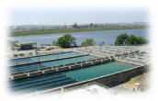

Importance of Microbial Resources
Biodiversity leads to Biobased Industry
Food
Health
Energy
MICROBES
Industry
Agriculture
Environment
Notes:
Microbes are one of the resources that are clearly useful for almost all sectors, ranging from energy to health.
At National Center for Genetic Engineering and Biotechnology, or BIOTEC, under NSTDA, MOST. We have a research unit that focus on microbial biotechnology
In order to support the utilization and innovation of bioscience and bioindustry, it is necessary to have a bioresource center that can support the sustainability use of microbes. The role of the bioresource center will not only include the management and service of microbial resources following the guideline of OECD, but the BRC will need to act as the initiator/supporter of several important network to stimulate the bioindustry establishment in the region.

Slide 5
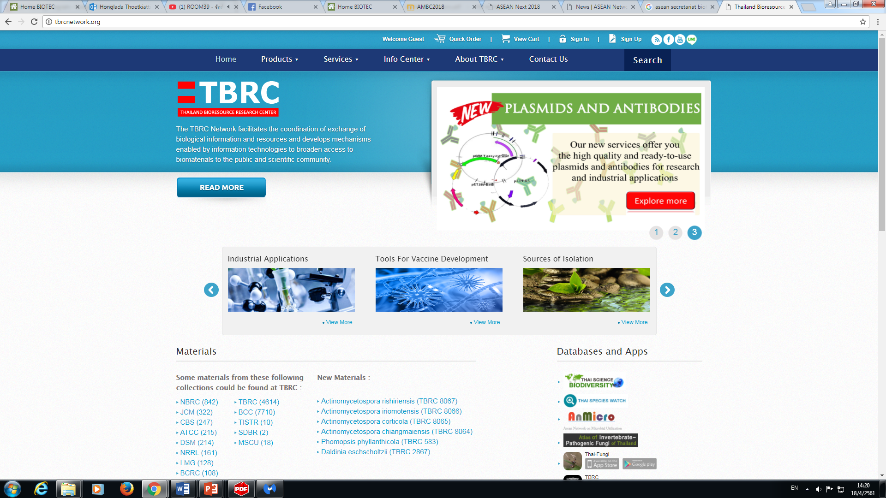



Thailand Bioresource Research Center (TBRC)
Biological resources
Information and computing infrastructure
Biological resources curator technology platform
Stroage facilities and backup sites
TBRC: no.1 of culture collection in Thailand
Thailand: No.8 OF culture collection in the global level
http://tbrcnetwork.org/
Notes:
TBRC: an intermediary for biological materials with application, information, and value
Microbial strains with “application”
Genome/ Metagenome collection
DNA/plasmids/Genetic materials
Antibodies
Cell lines
TBRC MAIN ACTIVITIES
Preserve microbial diversity/ microbiota
Provide access to
authenticated microbial resources
Associated data
Knowledge and Expertise in microbial biotechnology
Ensure the quality assurance and control of bioresources

Slide 6
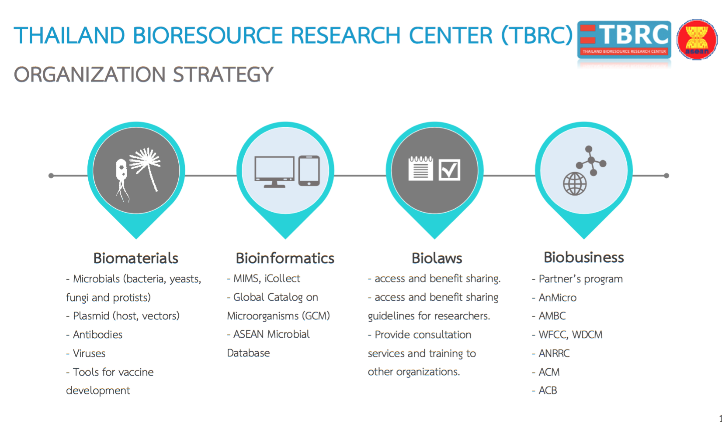
Isolation
Identification
Preservation
Research & Development
Depository/
Storage
Training
Preservation
Notes:
Mission
A. To serve as a central bioresource center for collecting biological materials and data using the management system that meets the highest international quality standard to ensure that all services provide the maximum utilization of bioresources.
B. To promote conservation and sustainable utilization of biological resources in compliance with the international legal framework (CBD, access and benefit sharing).
C. To establish national and international collaborations on biological material research.
D. To disseminate knowledge on biological material preservation and management through human resource development programs.

Slide 7





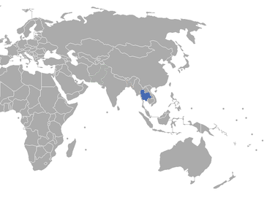










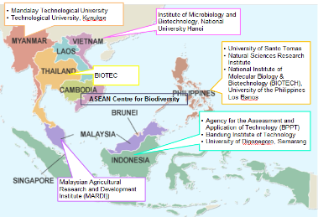



MOU
Korea National Research Resource Center (KNRRC), Korea
MOU
National Institute of Technology and Evaluation (NITE), Japan
Cebu Technological University (CTU), Philippines
Institute of Microbiology, Chinese Academy of Sciences (IMCAS), China
MARDI, Malaysia
Universiti Putra Malaysia (UPM)
MOU
MOU
สถาบันวิจัยวิทยาศาสตร์และเทคโนโลยีแห่งประเทศไทย (วว.;TISTR)
Badan Pengkajian dan Penerapan Teknologi (BPPT), Indonesia
จุฬาลงกรณ์มหาวิทยาลัย
Universitas diponegoro
มหาวิทยาลัยเชียงใหม่
Bandung Institute of Technology
มหาวิทยาลัยขอนแก่น

Slide 8

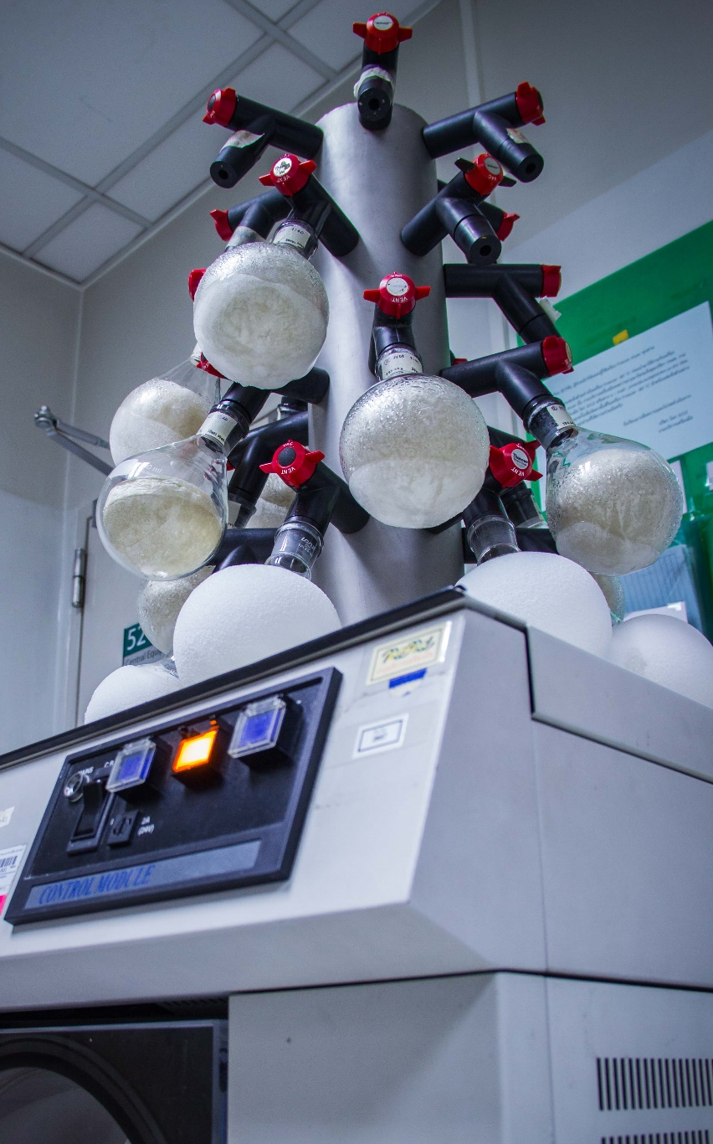


ASEAN Microbial Resource Database
No single BRCs could possess all of microbial resources
Bring together information from microbial resource centers to provide the integrative information view
Harmonization on quality standards (i.g., identification, preservation)
Facilitate access to resources and information
Copyright 2016 BIOTEC, NSTDA, Thailand

Slide 9

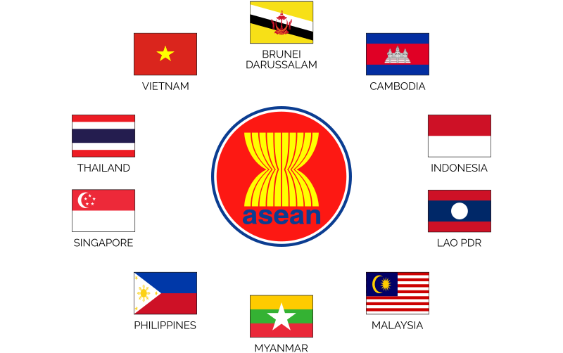





Establishment and Maintenance of an ASEAN Microbial Database
ASEAN COMMITTEE ON SCIENCE AND TECHNOLOGY (COST)
ASEAN PLAN OF ACTION ON SCIENCE, TECHNOLOGY AND INNOVATION (APASTI) FUNDING SCHEME
ASEAN SCIENCE, TECHNOLOGY AND INNOVATION FUND (ASTIF)
2020
ASEAN Microbial Database
WORKSHOP
TBRC
Thailand Bioresource Research Center
ACB
ASEAN Centre for Biodiversity
- Training on microbial data organization and management
- Post Workshop monitoring of the initial set of trainee regarding their acquired skills on microbial data organization and management
2017
ASEAN Network on Microbial Utilization
Notes:
AnMicro: ASEAN Network on Microbial Utilization
ACB: ASEAN Centre for Biodiversity
Our Mission To effectively facilitate regional cooperation and deliver capacity building services to the AMS in conserving biodiversity.
Capacity building on data Management of microbial resources
Facilitating access to microbial resources and information, Compliance with the ABS requirements
The aims of the asean microbial resources database are to build capacity on data management of microbial resource and to facilitate access to microbial resources and information and compliance with the ABS. in september this year, we will strat the first workshop for data management in Hanoi, Vietnam
Enhance awareness and understanding on microbial resources in the region through the establishment of an interoperable microbial database
b. Establish a common format for recording microbial strains based on globally accepted structures (e.g., Darwin Core, OECD, etc.), terminologies and metrics
c. Identify significant holders of microbial strains in the region
d. Establish a core team of trainers (from letter b) who will assist in providing technical support to other holders needing assistance in microbial data establishment
e. Develop a training programme for the organization and management of microbial resources in the region
f. Establish a common repository of interoperable microbial data which will be initially linked to individual data held by trained stakeholders in the region
g. Expand the ASEAN species database in the region to include not only plant and animal species but also microbial resources.

Slide 10
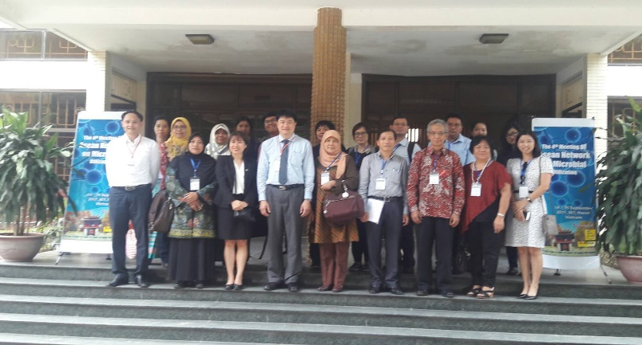
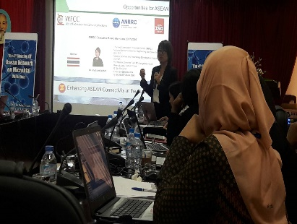
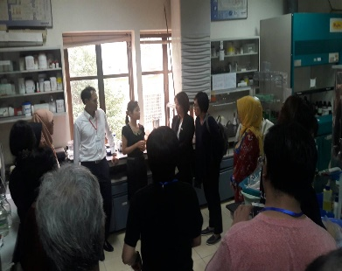
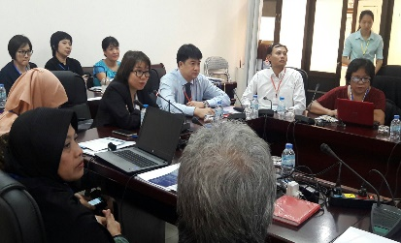
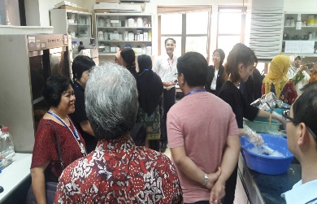
Activities
The 4th AnMicro Annual Meeting on 14 September 2017 at Institute of Biotechnology (IBT), Hanoi, Vietnam.
iCollect Workshop organized by BIOTEC Thailand to train on iCollect program with 28 participants from IBT, other institutes in Vietnam and AnMicro members.
Notes:
BIOTEC was hosting a joint workshop on microbial management: iCOLLECT as 28 participants from IBT, other institutes in Vietnam and AnMicro members attended the workshop. This workshop aimed to enhance human resource development through training as specified in the objective of the network.

Slide 11
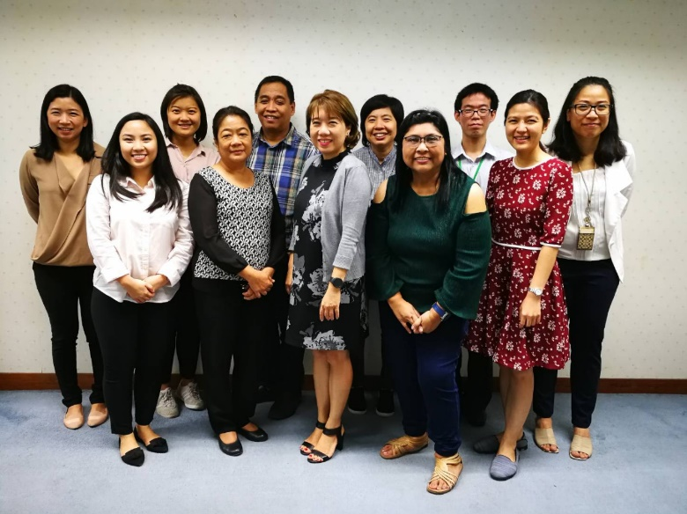

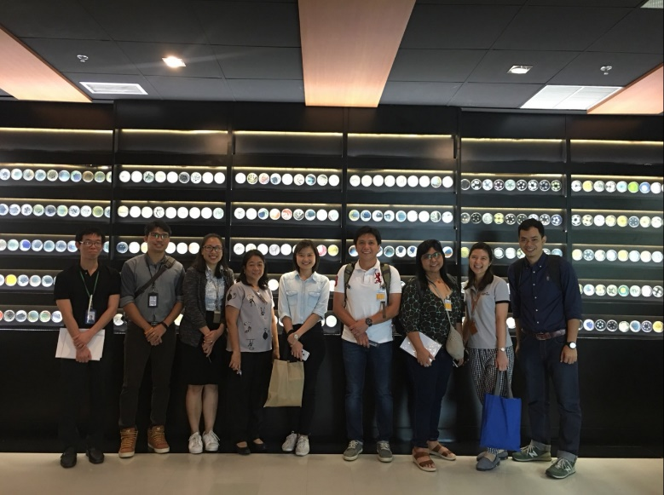
BIOTEC-ACB meeting on Establishment and Maintenance of an ASEAN Microbial Database on
January 22, 2018
Workshop on iCollect Program Thailand Bioresource Research Center (TBRC)
on January 23, 2018

Slide 12
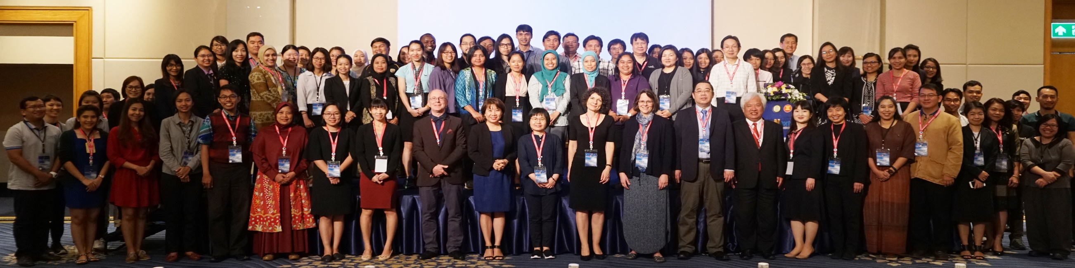
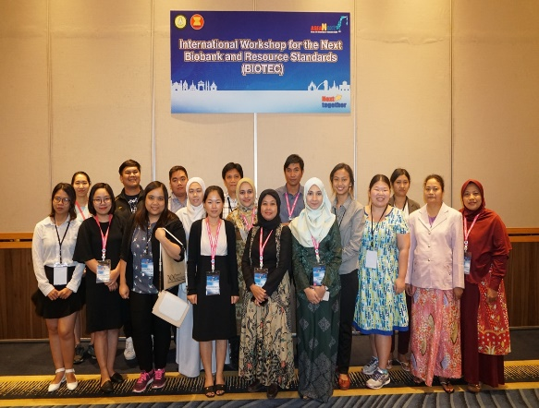
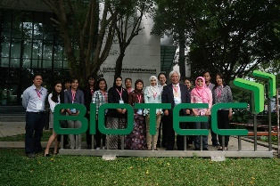
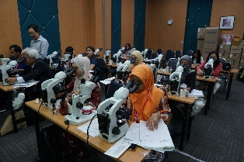
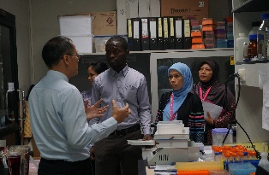
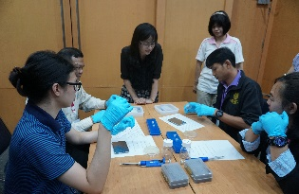
International workshop for The “next” Biobank and Bioresource Standards
March 21 – 23, 2018 at the Royal Orchid Sheraton Hotel and the Thailand Science Park
The aim of the workshop was to identify key roles and fundamental management systems in complying with international standard to meet the concept of biobank
There were two parallel workshops:
- Identification of Mitosporic fungi
- The Effective and reliable method of microbial biotyping by MALDI-TOF Mass Spectrometry
Notes:
The organizer provided 13 grants for AnMicro members and 6 grant for non-AnMicro member to participate in the workshop.
there were two parallel workshops, namely the “Identification of Mitosporic fungi” and the “Effective and reliable method of microbial biotyping by MALDI-TOF Mass Spectrometry”

Slide 13

THANK YOU
National Center for Genetic Engineering and Biotechnology (BIOTEC)

